Slide 1
Book1 PORUS SHEET STORY 2
File created on: 10/30/2023 10:00:00 AM

Slide 2
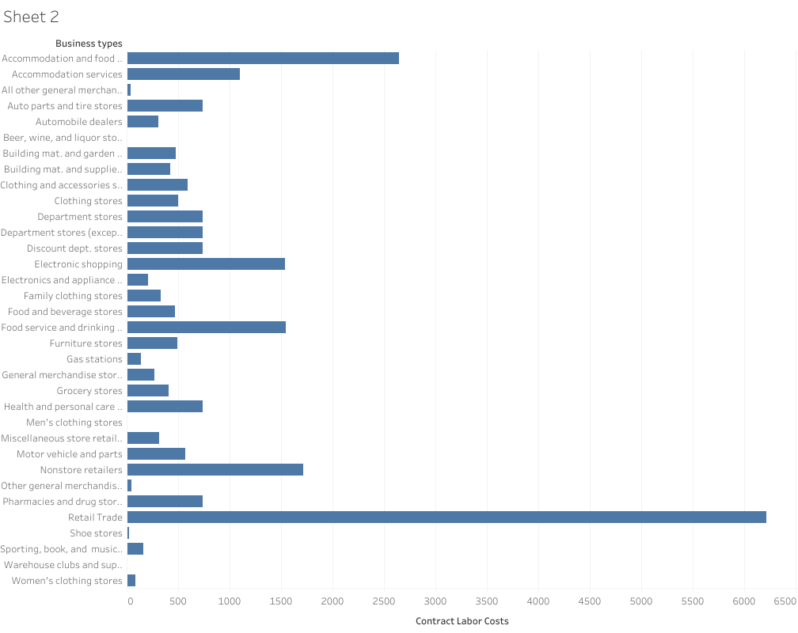

Slide 3
